Slide 1


Slide 2
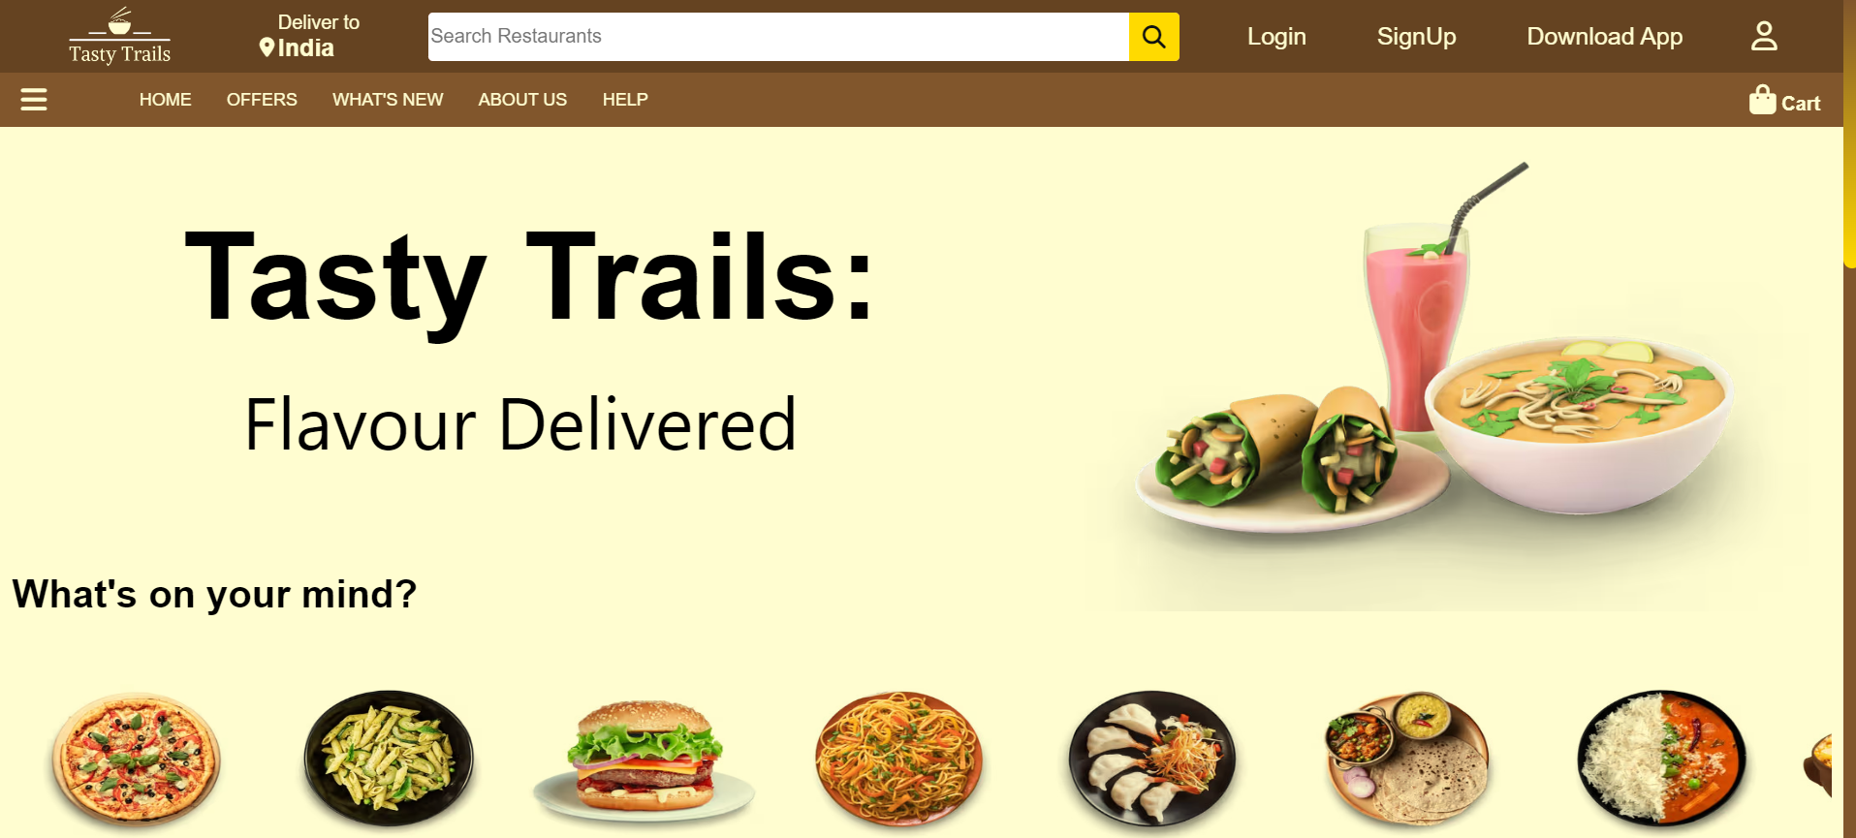
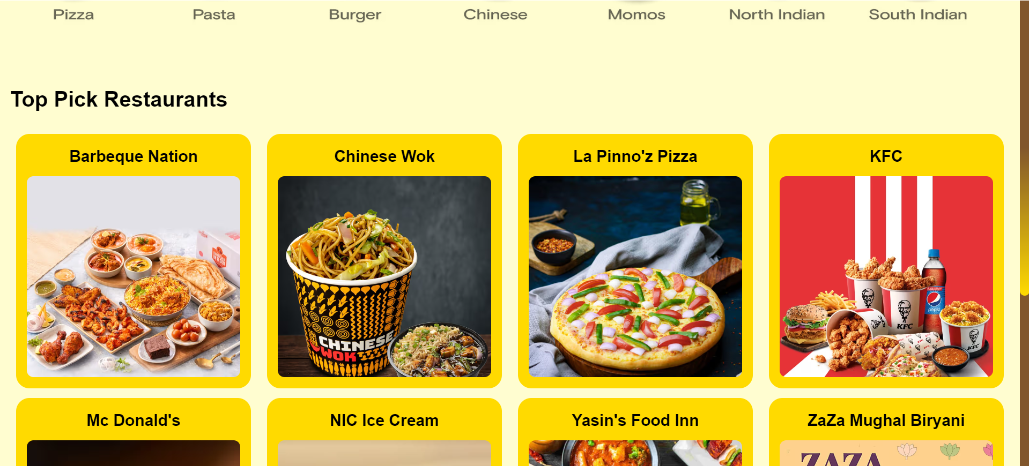


Slide 3


Slide 4
LANGUAGES

Slide 5
HTML & CSS
1
JavaScript
2
4
LANGUAGES
NodeJs
3
AngularJs

Slide 6
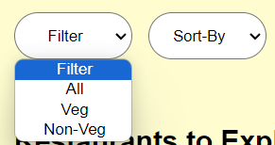


1
HTML & CSS
Used to add a drop down select list
HTML Tags:
There are several Html Tags, most of were used while building this website.
Some of the tags are as follows:
Bold/Italics → <b></b> <i></i>
Images → <img ></img>
Dropdown → <select></select>
And many more……..
Used to add Images
Used to add Images
Used to Edit Fonts (Bold/Italics/size)
Used to add Icons

Slide 7

1
HTML & CSS
CSS Scroll Bar
Displays all the dishes in the menu of various Restaurants

Slide 8
1
HTML & CSS
CSS Scroll Bar
All the Dishes get Enlarged when Hovered Over.

Slide 9

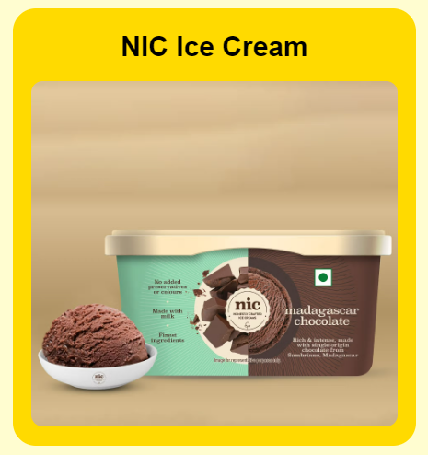
1
HTML & CSS
CSS Box Model
We used several CSS Box Models overall on our website.
This is the most used feature on the webpages. This feature is been used everywhere may it be visible or not.
It is being used to provide better visualizations and spacing between each component making it a little attractive.
Adding the Hover Transition to these box models helped us make it more eye-catching.

Slide 10
HTML & CSS
1
JavaScript
2
4
LANGUAGES
NodeJs
3
AngularJs

Slide 11
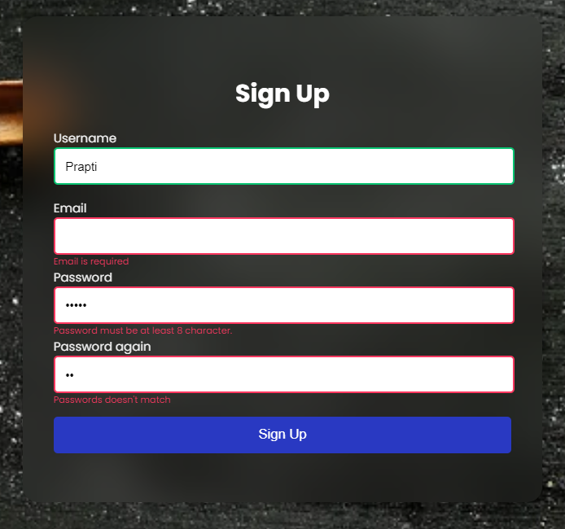
JavaScript
2
Form Validation
Checks if all the Fields are filled
Checks for a valid Email Id
Checks for a valid Password format
Checks if the Both the Passwords entered are same.

Slide 12
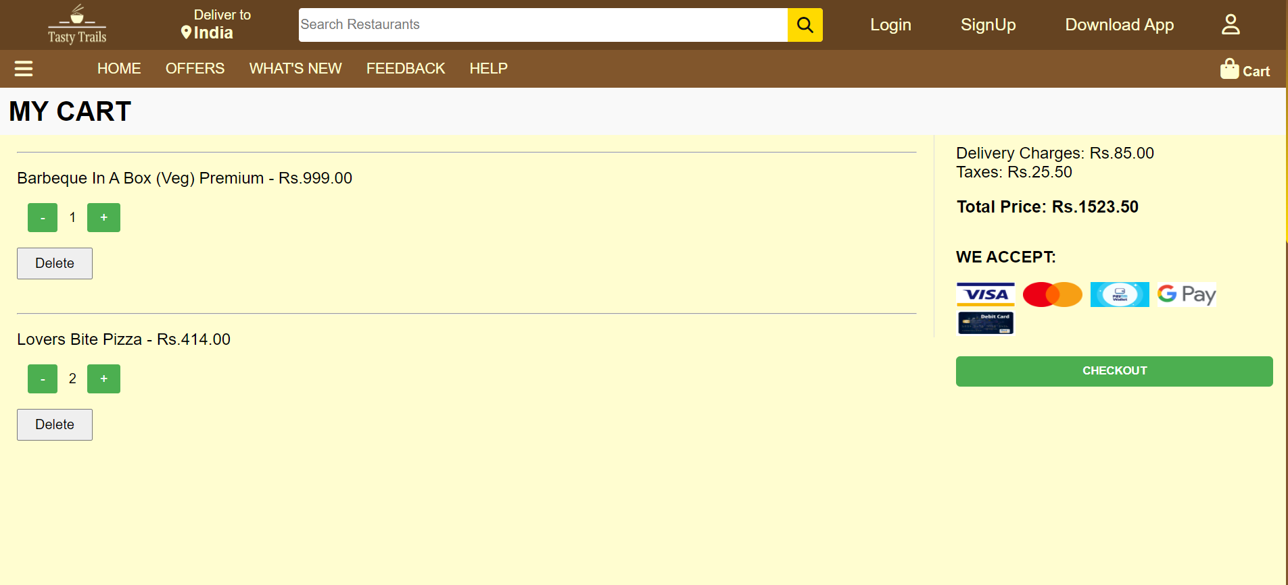
JavaScript
2
Cart Management
Retrieves cart items from local storage or initializes an empty array if no items are stored.
Dynamically updates the cart display.
Manages user interaction

Slide 13
JavaScript
2
Cart Management
Retrieves cart items from local storage or initializes an empty array if no items are stored.
Dynamically updates the cart display.
Manages user interaction

Slide 14
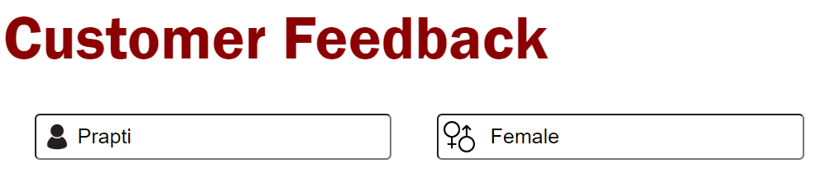
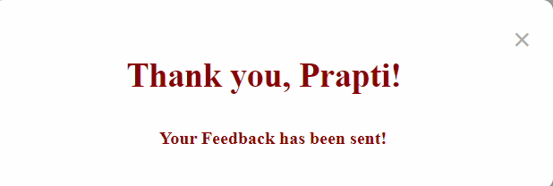
HTML & CSS
1
JavaScript
2
4
LANGUAGES
NodeJs
3
AngularJs

Slide 15
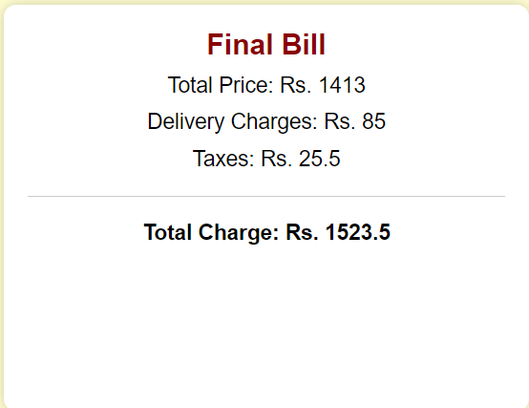
3
AngularJs
Used to define an application module named 'feedbackApp' in the <html> tag using ng-app="feedbackApp".
AngularJS directives such as ng-model, ng-submit, and ng-click are used to bind data, handle form submission, and trigger events respectively.
AngularJS's dependency injection is utilized to inject the $scope and $window services into the controller function.

Slide 16
3
AngularJs
Similar approach has been taken for this webpage

Slide 17
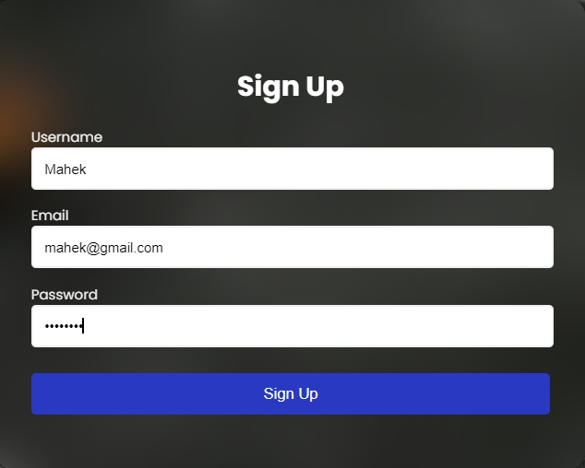
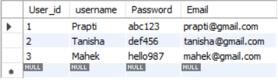
HTML & CSS
1
JavaScript
2
4
LANGUAGES
NodeJs
3
Angular Js

Slide 18
4
NodeJs
SQL Connectivity
We utilized Node.js for database connectivity, specifically for storing user credentials such as usernames and passwords in a MySQL database.

Slide 19
HTML & CSS
1
JavaScript
2
4
LANGUAGES
NodeJs
3
AngularJs

Slide 20
THANKYOU

